Slide 1


 | Dothan Gun Club – Steel Challenge Match
START POSITION : Standing in shooting box.
GUN READY CONDITIONS : Centerfire pistol: gun loaded, holstered, wrists above respective shoulders. Rimfire pistol, rimfire rifle, and PCC: gun loaded and aimed at orange cone/aiming point. |  | SCORING: 5 strings of 5 hits per stage. Worst string in each stage is discarded. TARGETS: 5 Steel SCORED HITS: Hit anywhere on face of steel START-STOP: Audible, hit on stop plate or 30 seconds per string RULES: Each miss per string adds 3 seconds to that string’s time. Hitting the stop plate first in a string makes the time for that string 30 seconds.
STAGE PROCEDURE: Engage each steel with one hit then engage the stop plate with one hit.
P1
X
X

Slide 2
 | Dothan Gun Club – Steel Challenge Match
START POSITION : Standing in shooting box.
GUN READY CONDITIONS : Centerfire pistol: gun loaded, holstered, wrists above respective shoulders. Rimfire pistol, rimfire rifle, and PCC: gun loaded and aimed at orange cone/aiming point. |  | SCORING: 5 strings of 5 hits per stage. Worst string in each stage is discarded. TARGETS: 5 Steel SCORED HITS: Hit anywhere on face of steel START-STOP: Audible, hit on stop plate or 30 seconds per string RULES: Each miss per string adds 3 seconds to that string’s time. Hitting the stop plate first in a string makes the time for that string 30 seconds.
STAGE PROCEDURE: Engage each steel with one hit then engage the stop plate with one hit.
P1
X
X

Slide 3
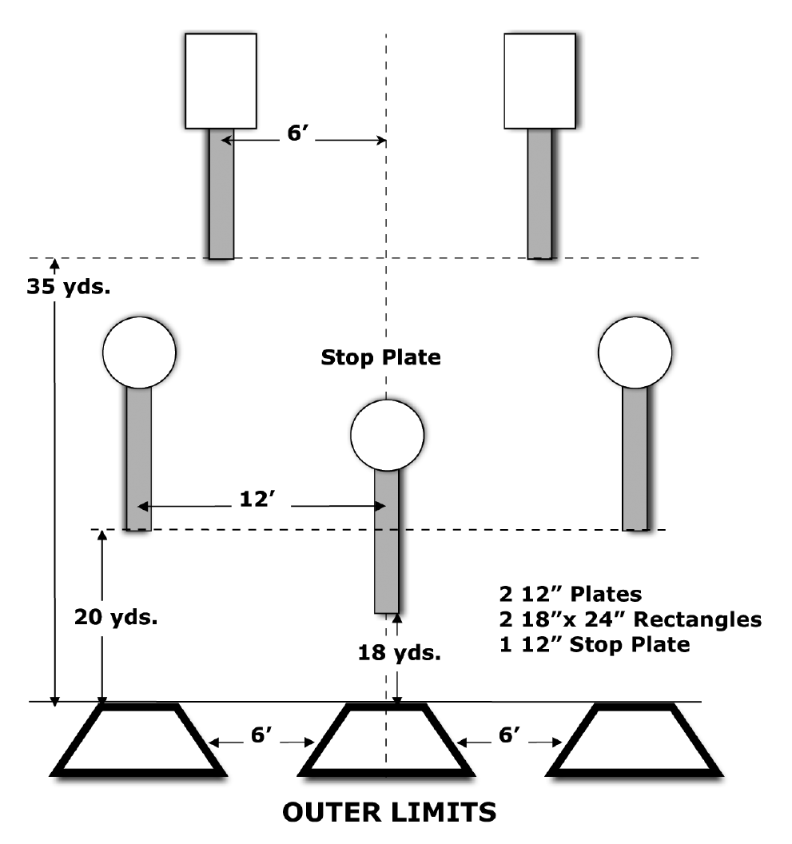
 | Dothan Gun Club – Steel Challenge Match Outer Limits
START POSITION : Starting in weak side shooting box (right handed shooters in left box, left handed in right box)
GUN READY CONDITIONS : Centerfire pistol: gun loaded, holstered, wrists above respective shoulders. Rimfire pistol, rimfire rifle, and PCC: gun loaded and aimed at orange cone/aiming point. |  | SCORING: 4 strings of 5 hits per stage. Worst string in each stage is discarded. TARGETS: 5 Steel SCORED HITS: Hit anywhere on face of steel START-STOP: Audible, hit on stop plate or 30 seconds per string RULES: Each miss per string adds 3 seconds to that string’s time. Hitting the stop plate first in a string makes the time for that string 30 seconds. Hitting a plate from the wrong shooting box will be scored as a miss
STAGE PROCEDURE: Engage the 25 and 35 yard targets on the weak side of the center line, move to the center box and engage the remaining targets plus stop plate.
P1
X
X

Slide 4
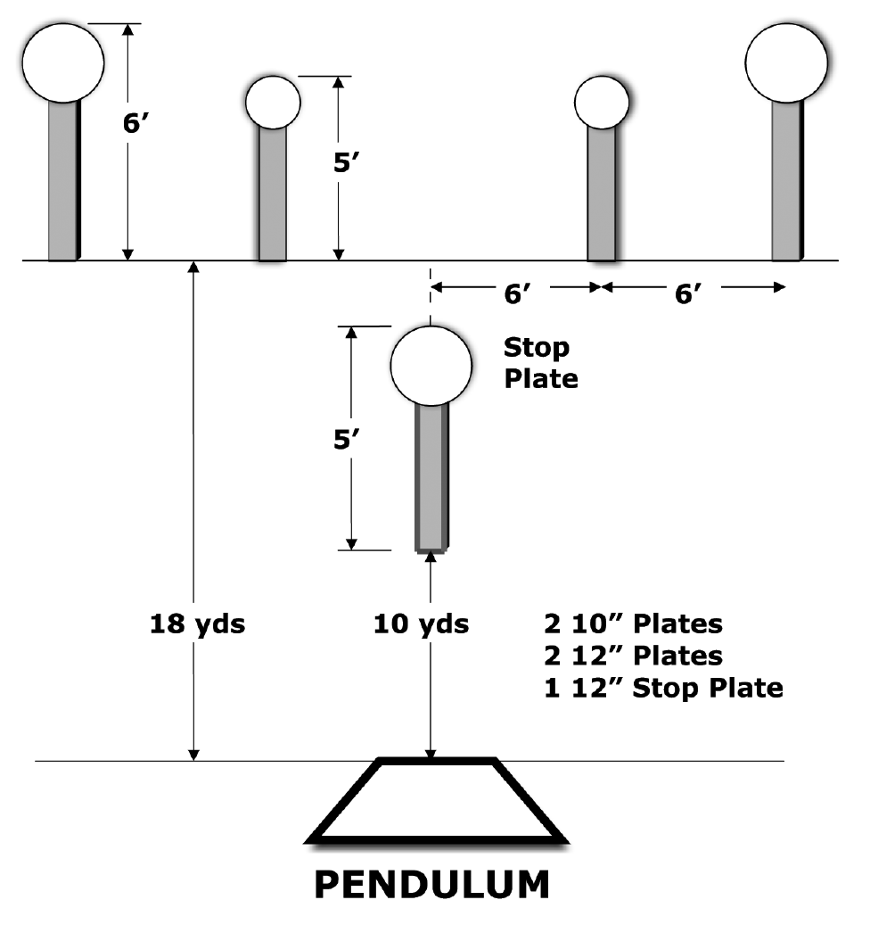
 | Dothan Gun Club – Steel Challenge Match Pendulum
START POSITION : Standing in shooting box.
GUN READY CONDITIONS : Centerfire pistol: gun loaded, holstered, wrists above respective shoulders. Rimfire pistol, rimfire rifle, and PCC: gun loaded and aimed at orange cone/aiming point. |  | SCORING: 5 strings of 5 hits per stage. Worst string in each stage is discarded. TARGETS: 5 Steel SCORED HITS: Hit anywhere on face of steel START-STOP: Audible, hit on stop plate or 30 seconds per string RULES: Each miss per string adds 3 seconds to that string’s time. Hitting the stop plate first in a string makes the time for that string 30 seconds.
STAGE PROCEDURE: Engage each steel with one hit then engage the stop plate with one hit.
P1
X
X

Slide 5
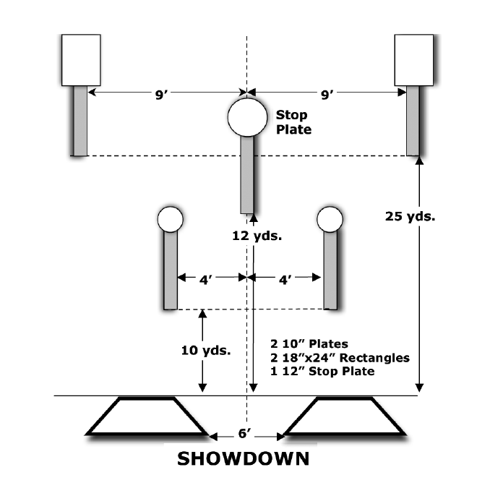
 | Dothan Gun Club – Steel Challenge Match Showdown
START POSITION : Standing in either shooting box.
GUN READY CONDITIONS : Centerfire pistol: gun loaded, holstered, wrists above respective shoulders. Rimfire pistol, rimfire rifle, and PCC: gun loaded and aimed at orange cone/aiming point. |  | SCORING: 5 strings of 5 hits per stage. Worst string in each stage is discarded. TARGETS: 5 Steel SCORED HITS: Hit anywhere on face of steel START-STOP: Audible, hit on stop plate or 30 seconds per string RULES: Each miss per string adds 3 seconds to that string’s time. Hitting the stop plate first in a string makes the time for that string 30 seconds.
STAGE PROCEDURE: Engage each steel with one hit then engage the stop plate with one hit. Shoot two strings from one box, and three from the other. Movement is not on the clock and shooter may choose when to move. Shooting more than three strings from a single box will be a reshoot until they move to the next box.
P1
X
X

Slide 6
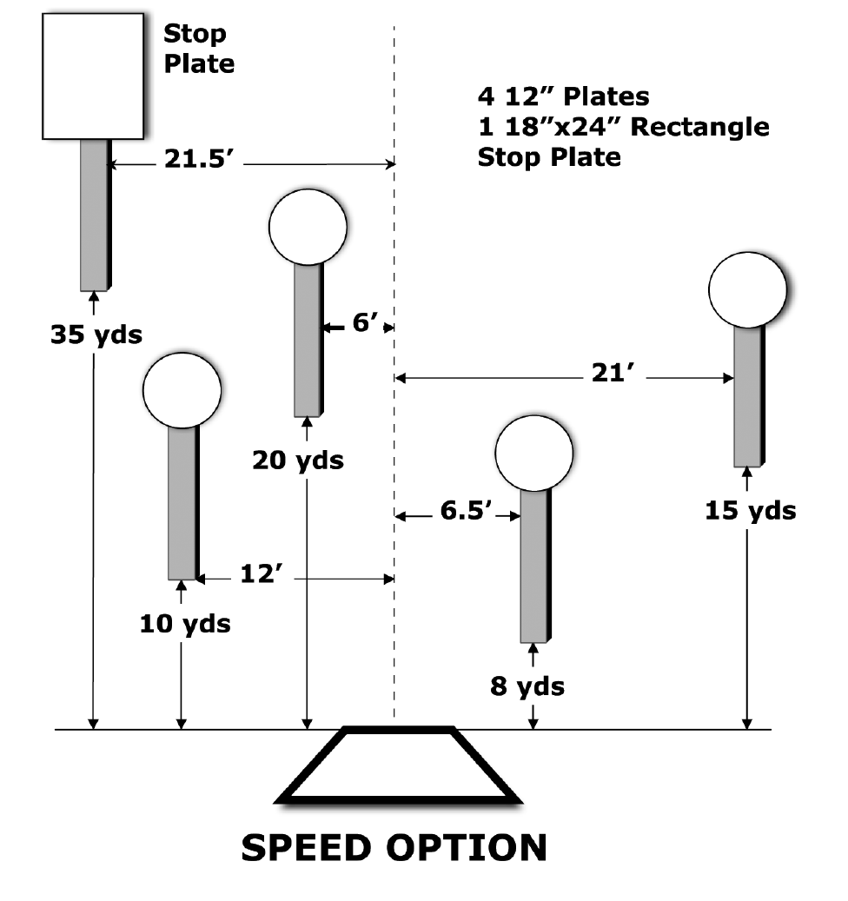
 | Dothan Gun Club – Steel Challenge Match Speed Option
START POSITION : Standing in shooting box.
GUN READY CONDITIONS : Centerfire pistol: gun loaded, holstered, wrists above respective shoulders. Rimfire pistol, rimfire rifle, and PCC: gun loaded and aimed at orange cone/aiming point. |  | SCORING: 5 strings of 5 hits per stage. Worst string in each stage is discarded. TARGETS: 5 Steel SCORED HITS: Hit anywhere on face of steel START-STOP: Audible, hit on stop plate or 30 seconds per string RULES: Each miss per string adds 3 seconds to that string’s time. Hitting the stop plate first in a string makes the time for that string 30 seconds.
STAGE PROCEDURE: Engage each steel with one hit then engage the stop plate with one hit.
P1
X
X

